Slide 1
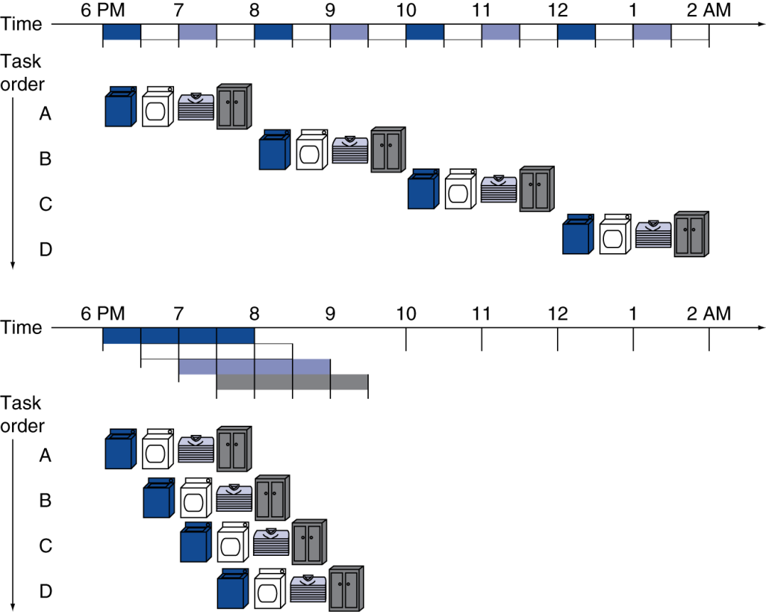
Pipelining Analogy
Pipelined laundry: overlapping execution
Parallelism improves performance
§4.5 An Overview of Pipelining
Four loads:
Speedup = 8/3.5 = 2.3
Infinite loads:
Speedup = 4n/(3+n) ≈ 4 = number of stages

Slide 2
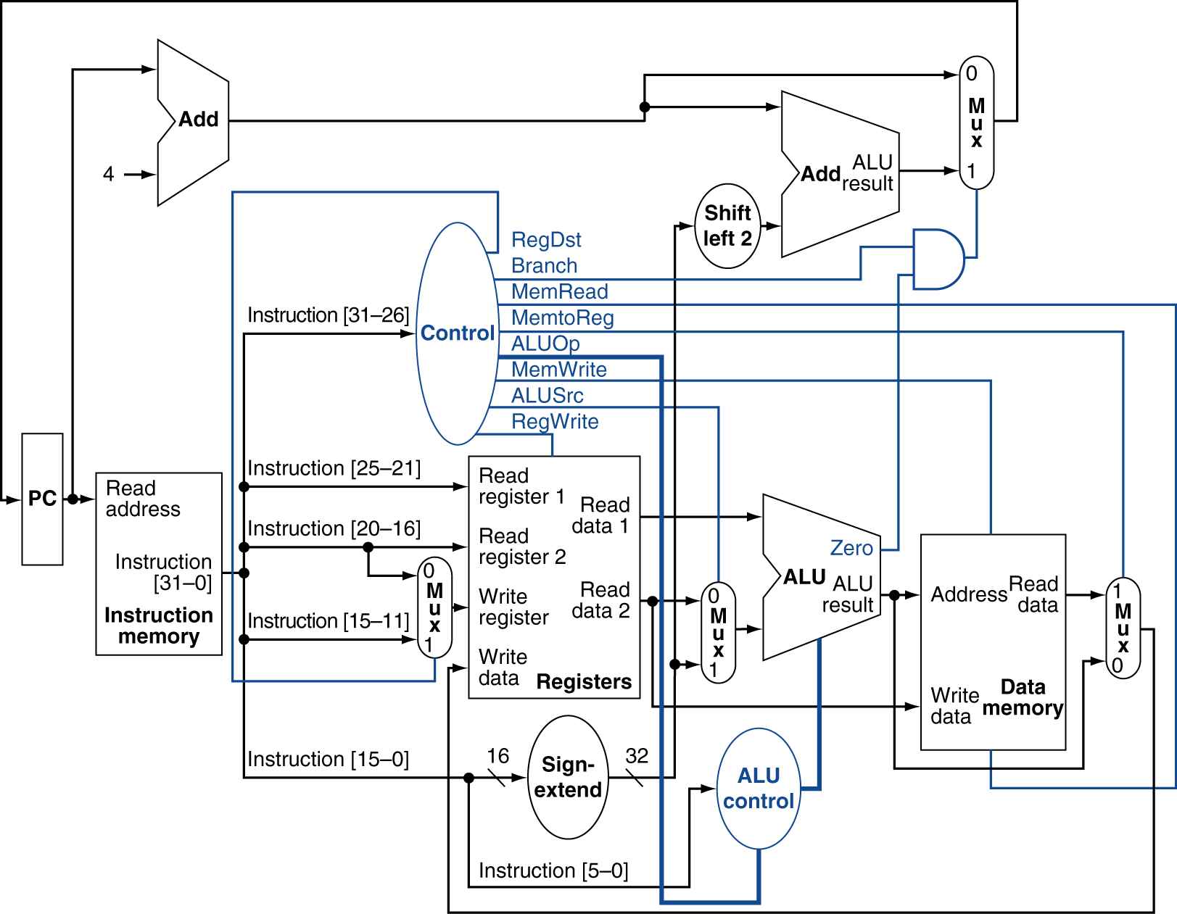
Datapath With Control

Slide 3
Pipelining 을 하려면
load 를 여러 개의 sub-task 로 나누어야 함
각 sub-task 는 1-clock cycle 에 수행된다.

Slide 4
MIPS Pipeline
Five stages, one step per stage
IF: Instruction fetch from memory
ID: Instruction decode & register read
EX: Execute operation or calculate address
MEM: Access memory operand
WB: Write result back to register

Slide 5
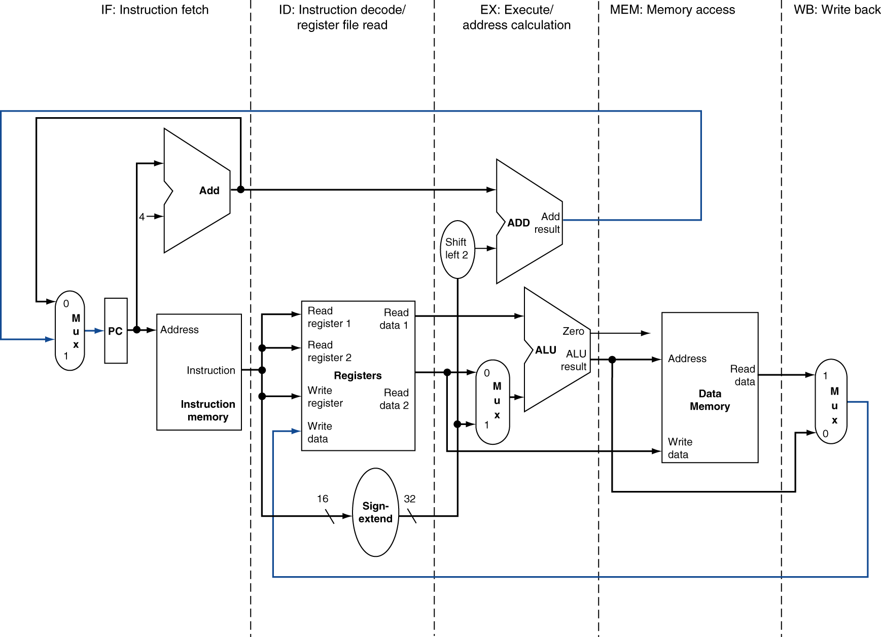
MIPS Pipelined Datapath
§4.6 Pipelined Datapath and Control
MEM
Right-to-left flow leads to hazards
WB

Slide 6
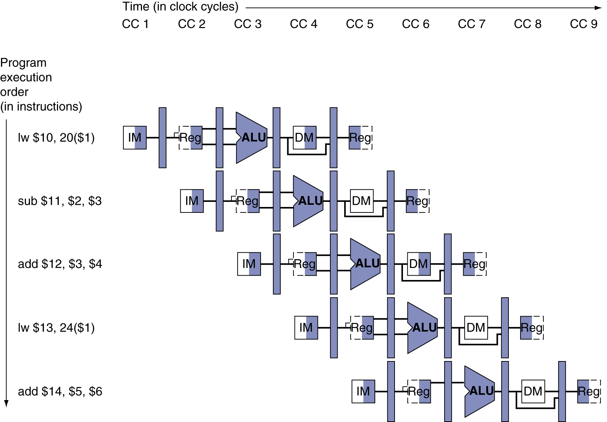
Multi-Cycle Pipeline Diagram
Form showing resource usage

Slide 7
tesseract from movie “interstellar”(2014)

Slide 8
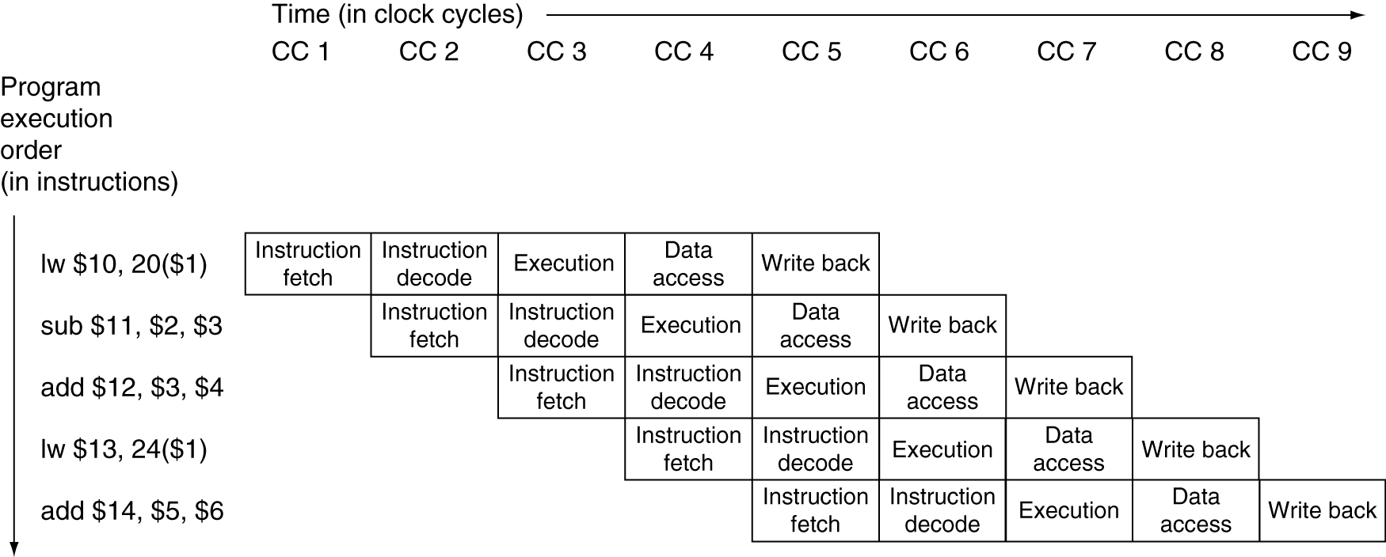
Multi-Cycle Pipeline Diagram
Traditional form

Slide 9
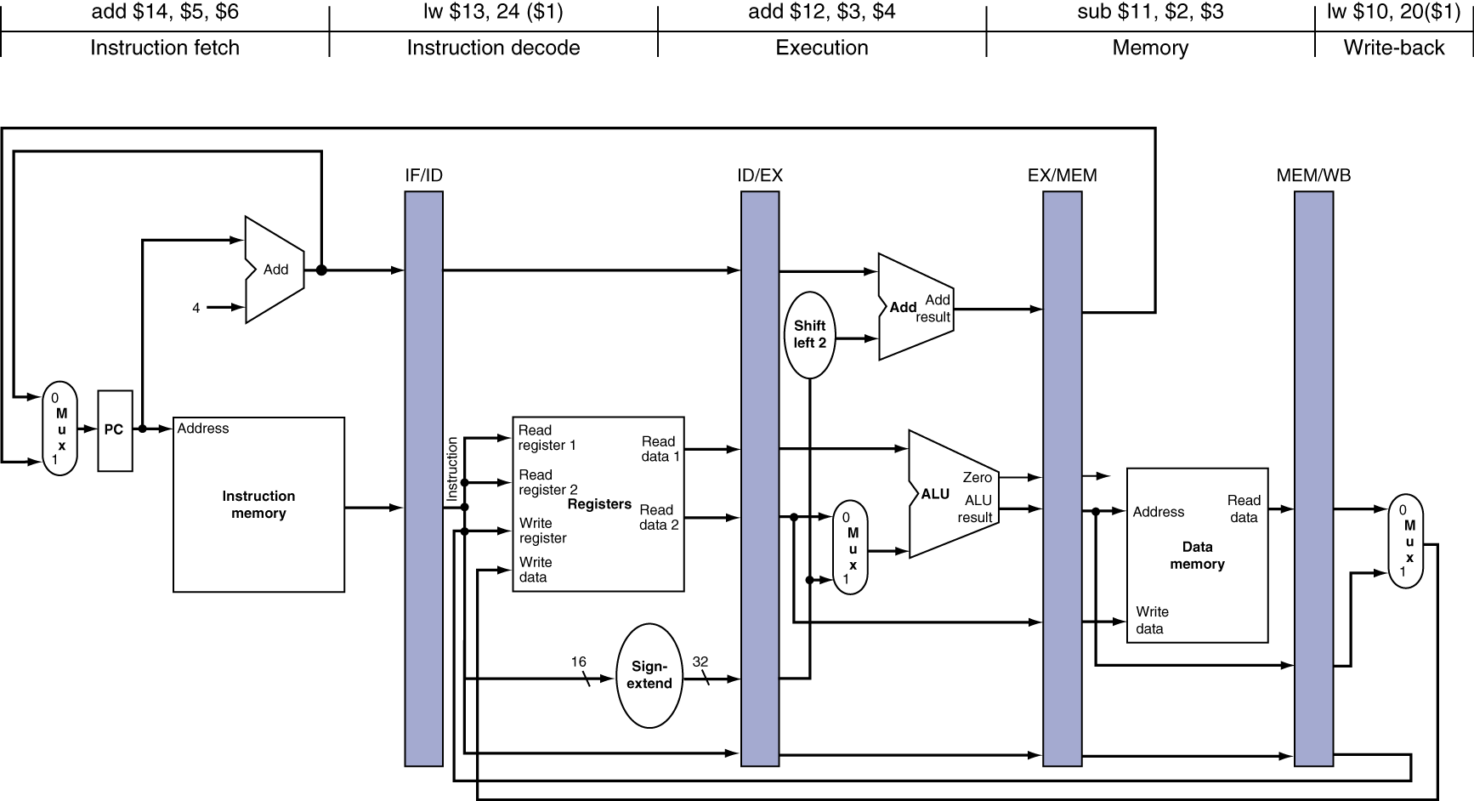
Single-Cycle Pipeline Diagram
State of pipeline in a given cycle (CC5)

Slide 10
Pipeline Operation
Cycle-by-cycle flow of instructions through the pipelined datapath
“Single-clock-cycle” pipeline diagram
Shows pipeline usage in a single cycle
Highlight resources used
c.f. “multi-clock-cycle” diagram
Graph of operation over time
We’ll look at “single-clock-cycle” diagrams for load & store

Slide 11
Pipeline Performance
Assume time for stages is
100ps for register read or write
200ps for other stages
Compare pipelined datapath with single-cycle datapath
Instr | Instr fetch | Register read | ALU op | Memory access | Register write | Total time
lw | 200ps | 100 ps | 200ps | 200ps | 100 ps | 800ps
sw | 200ps | 100 ps | 200ps | 200ps |  | 700ps
R-format | 200ps | 100 ps | 200ps |  | 100 ps | 600ps
beq | 200ps | 100 ps | 200ps |  |  | 500ps

Slide 12
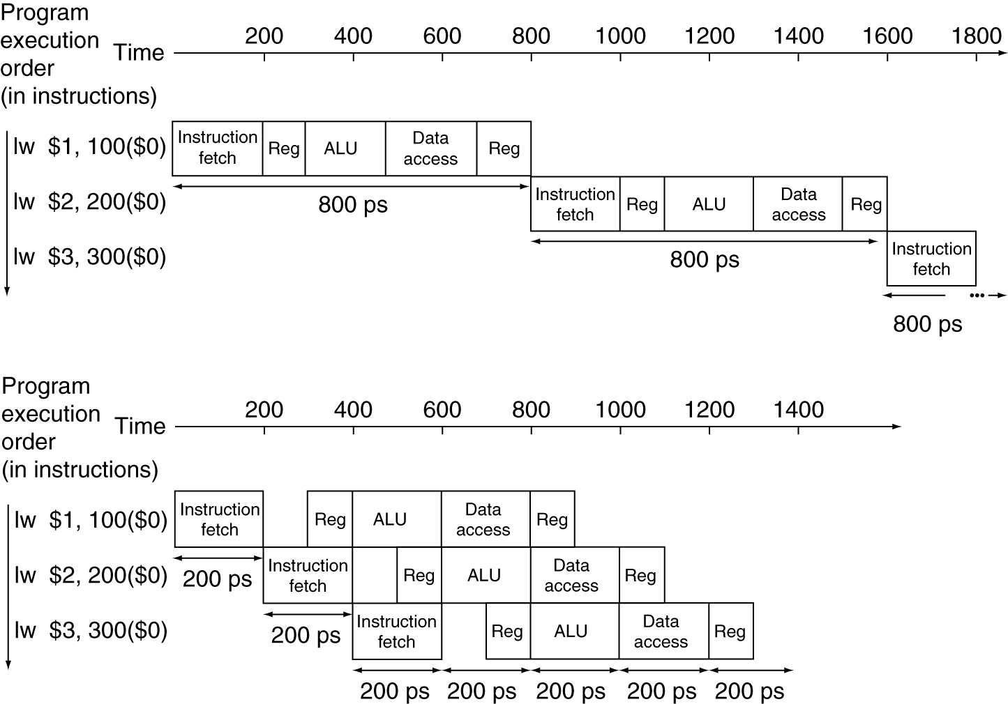
Pipeline Performance
Single-cycle (T_{c}= 800ps)
Pipelined (T_{c}= 200ps)

Slide 13
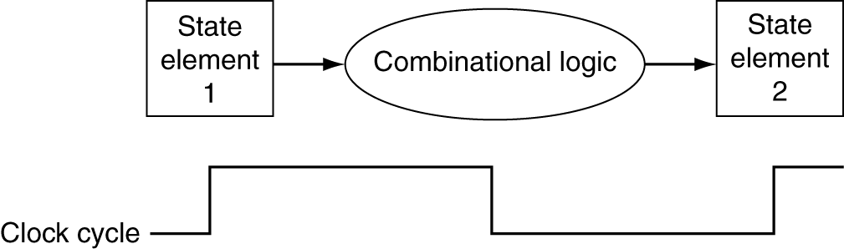
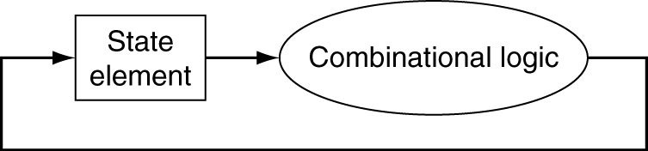
Clocking Methodology
Combinational logic transforms data during clock cycles
Between clock edges
Input from state elements, output to state element
Longest delay determines clock period

Slide 14
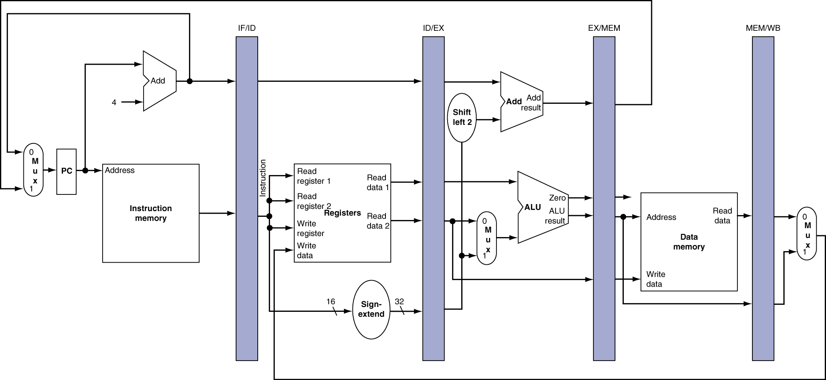
Pipeline registers
Need registers between stages
To hold information produced in previous cycle

Slide 15
Single-Cycle Pipeline Diagram
State of pipeline in CC5

Slide 16
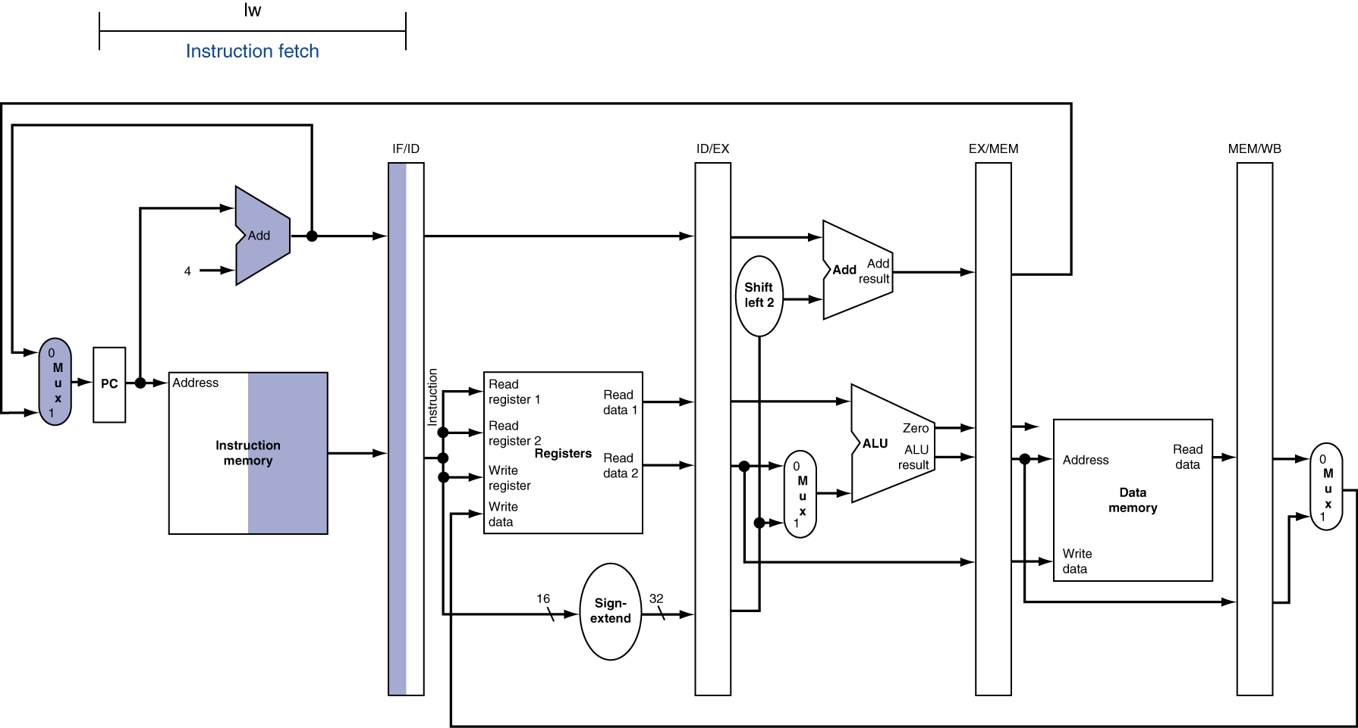
IF for Load at CC1

Slide 17
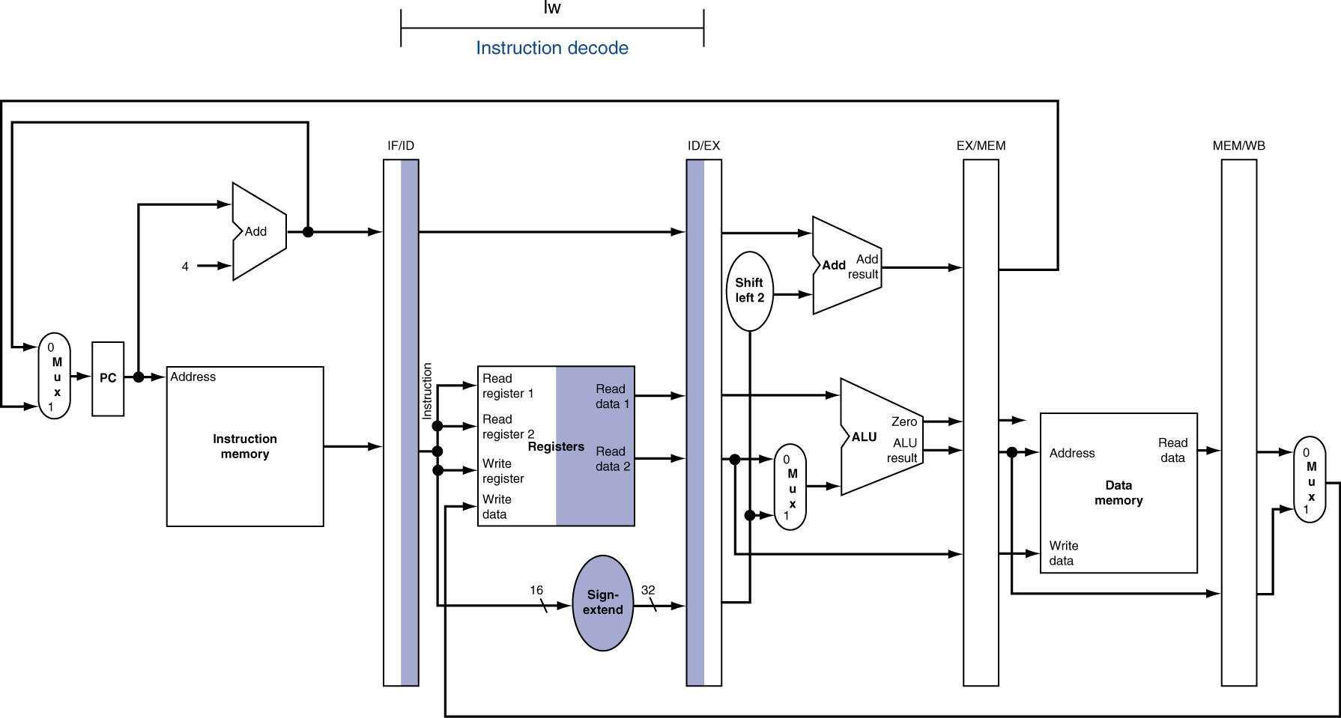
ID for Load at CC2

Slide 18
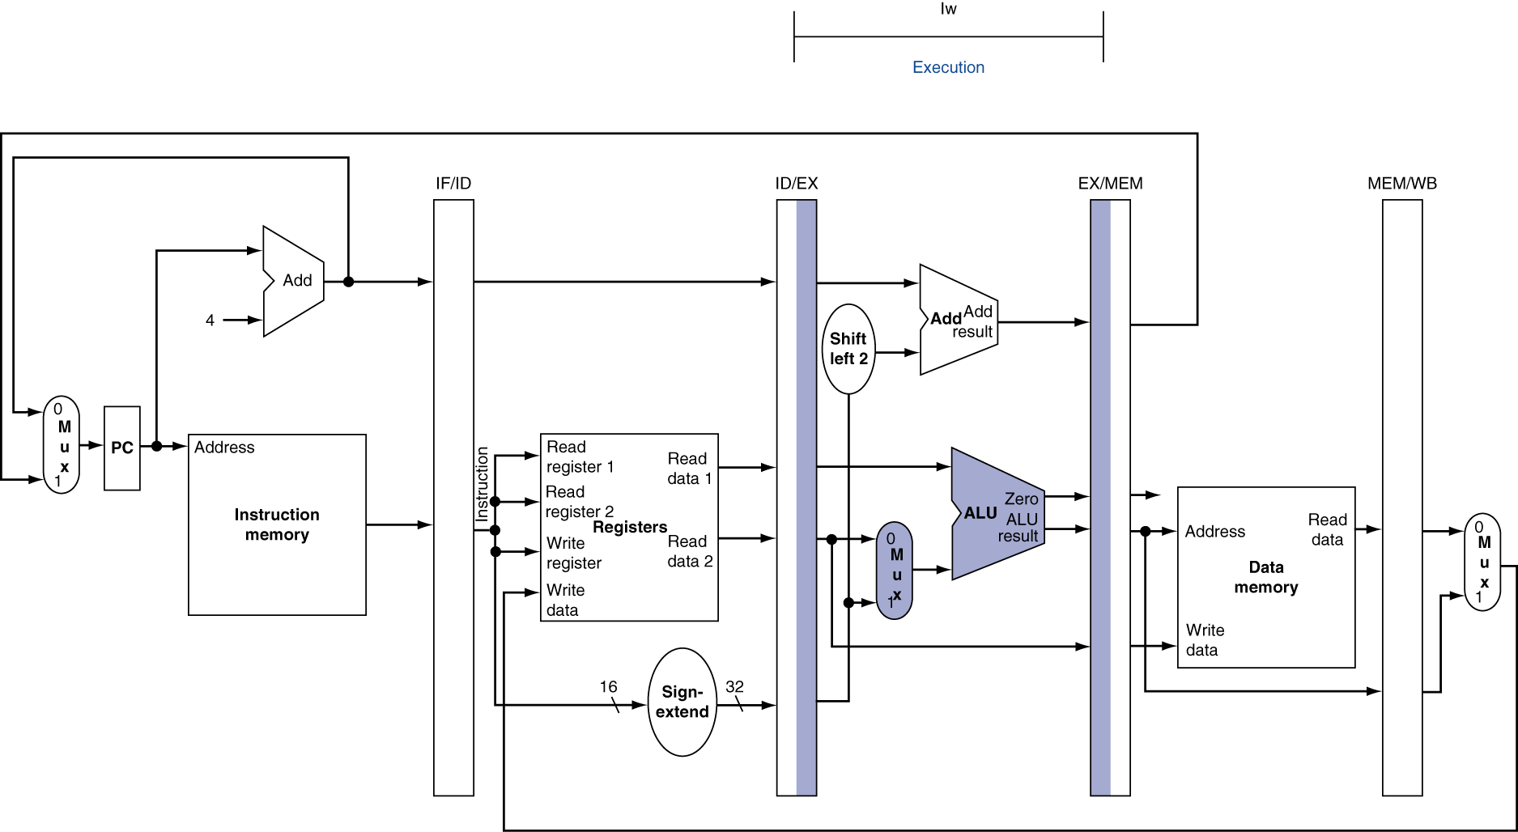
EX for Load at CC3

Slide 19
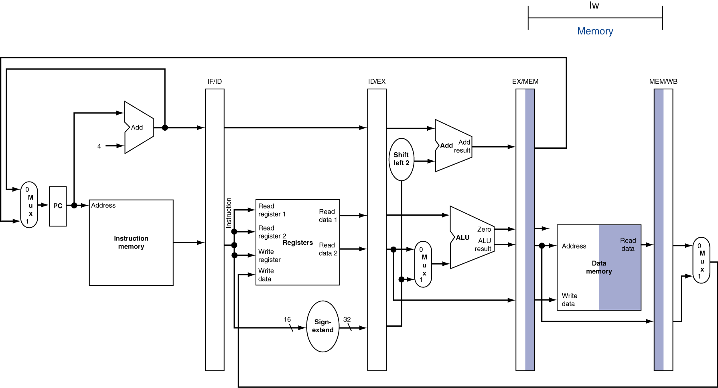
MEM for Load at CC4

Slide 20
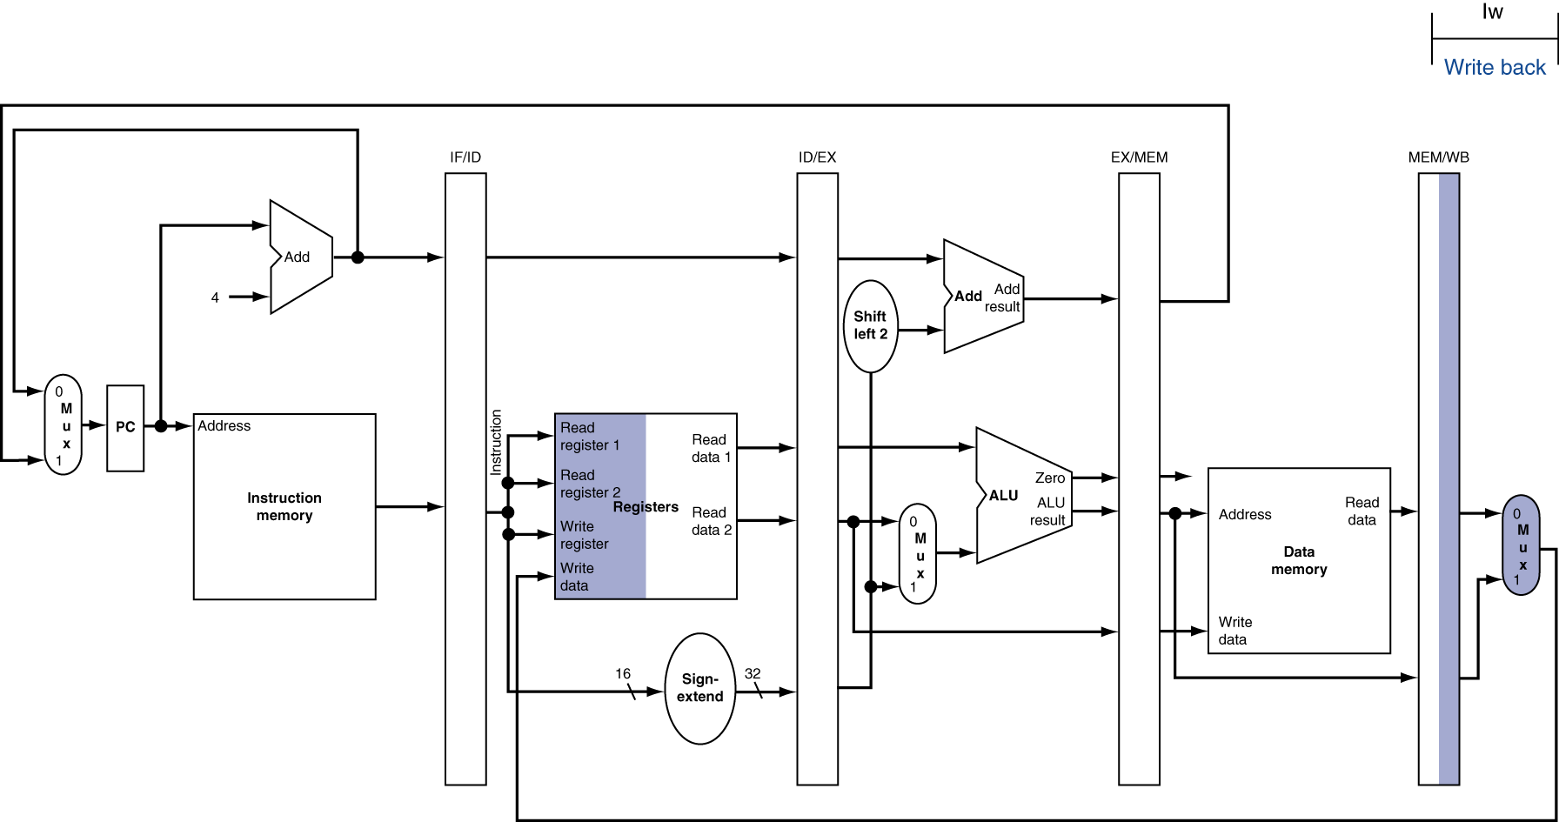
WB for Load at CC5
Wrong register number

Slide 21
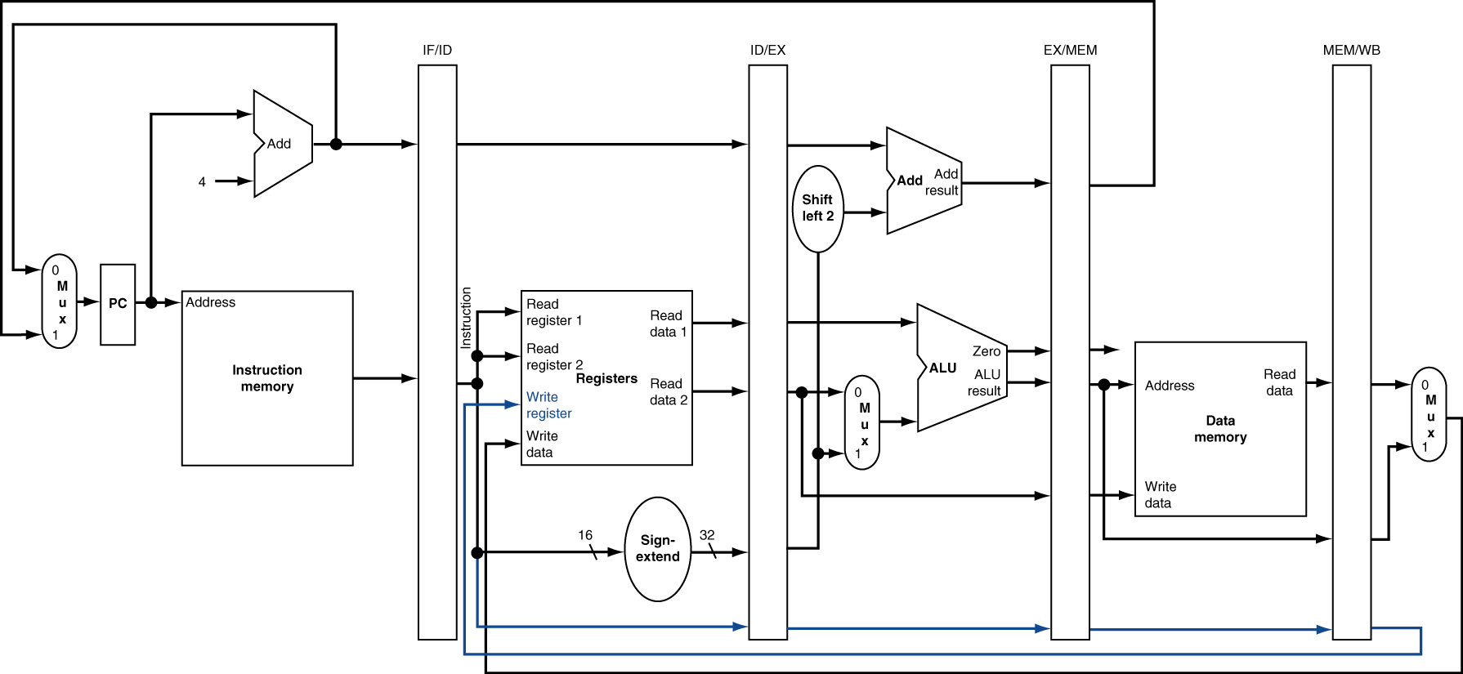
Corrected Datapath for Load

Slide 22

EX for Store

Slide 23
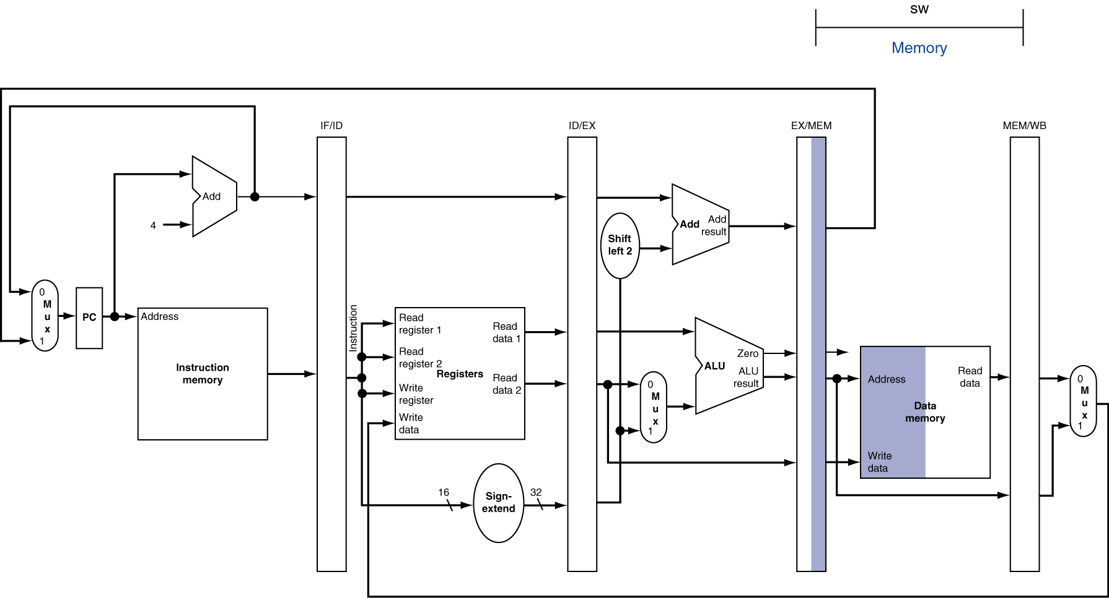
MEM for Store

Slide 24
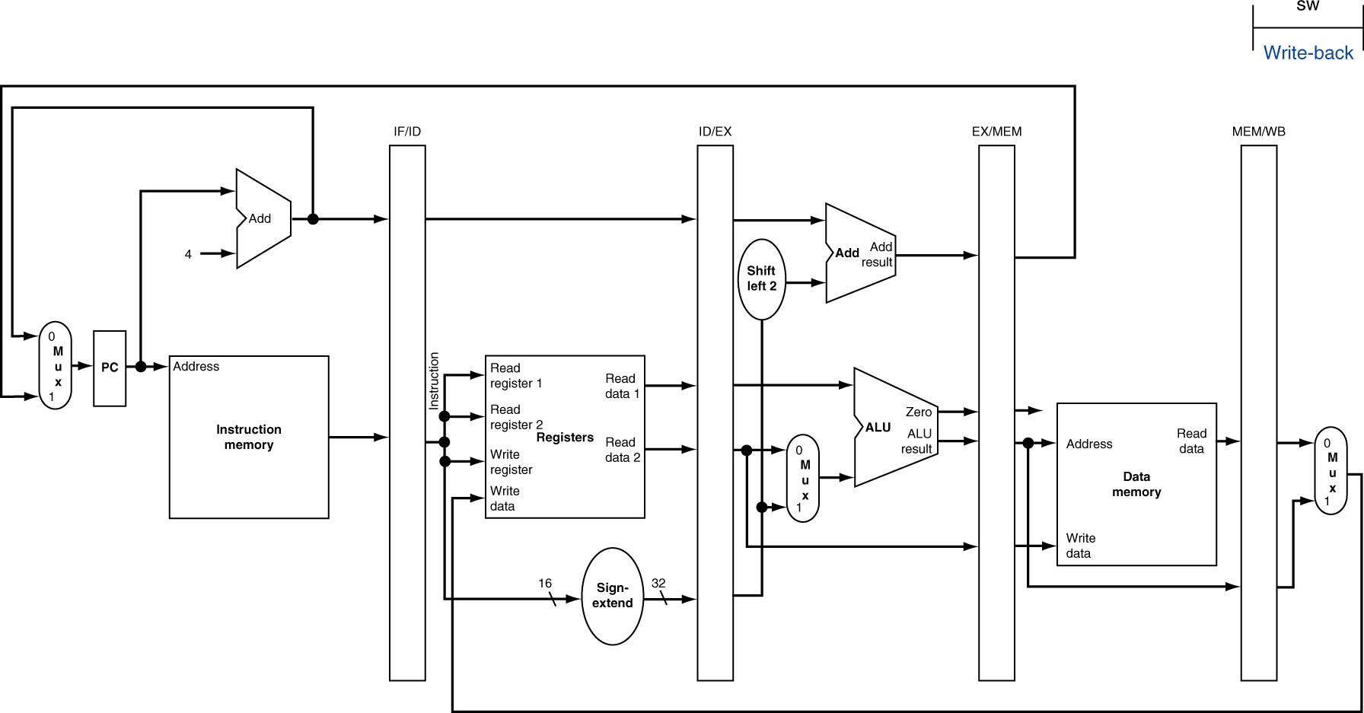
WB for Store

Slide 25
Single-Cycle Pipeline Diagram
State of pipeline at CC5

Slide 26
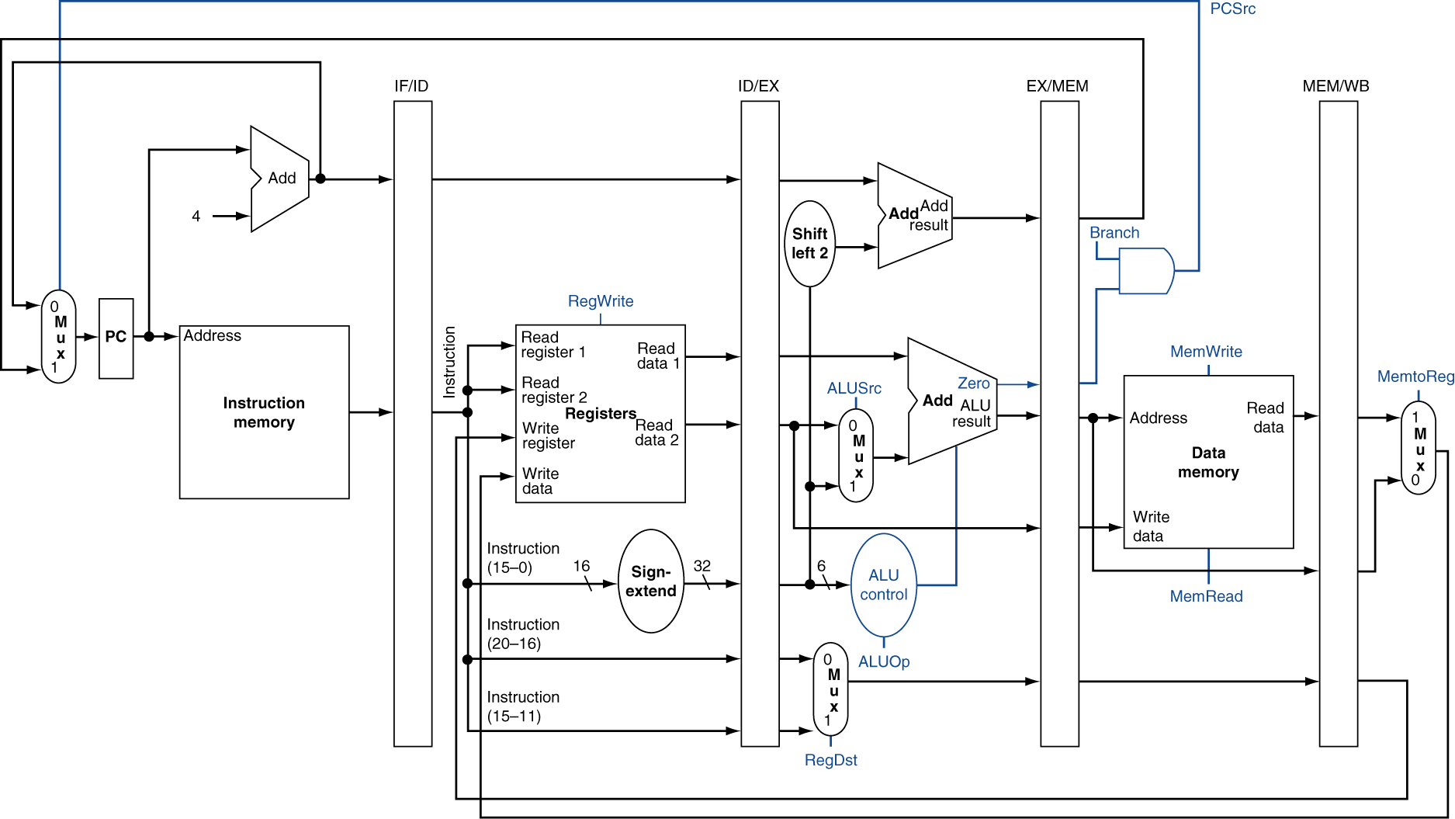
Pipelined Control (Simplified)

Slide 27
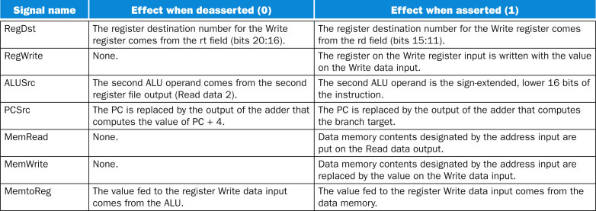
Control Signals

Slide 28
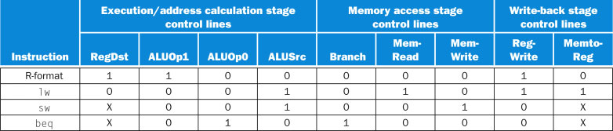
Control Signals

Slide 29
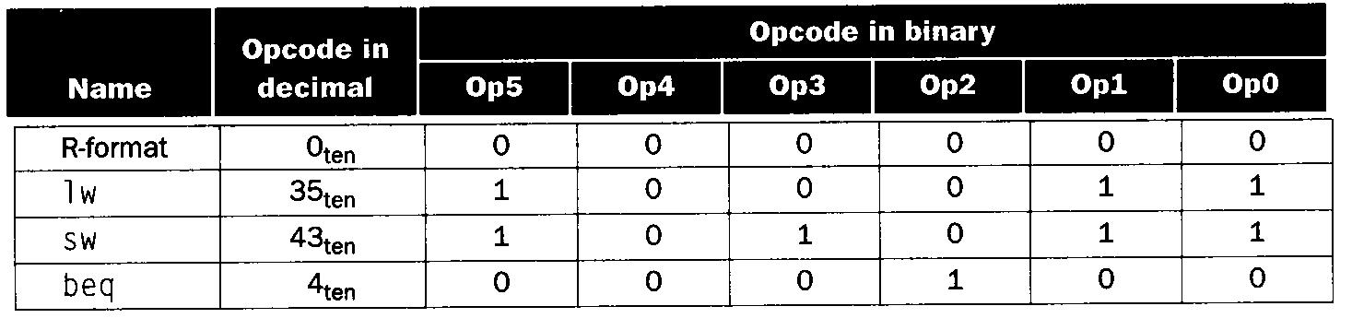
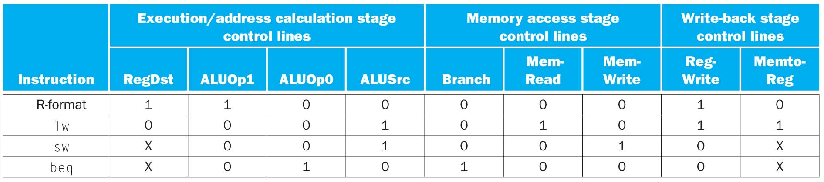
Truth Table for Pipeline Control

Slide 30
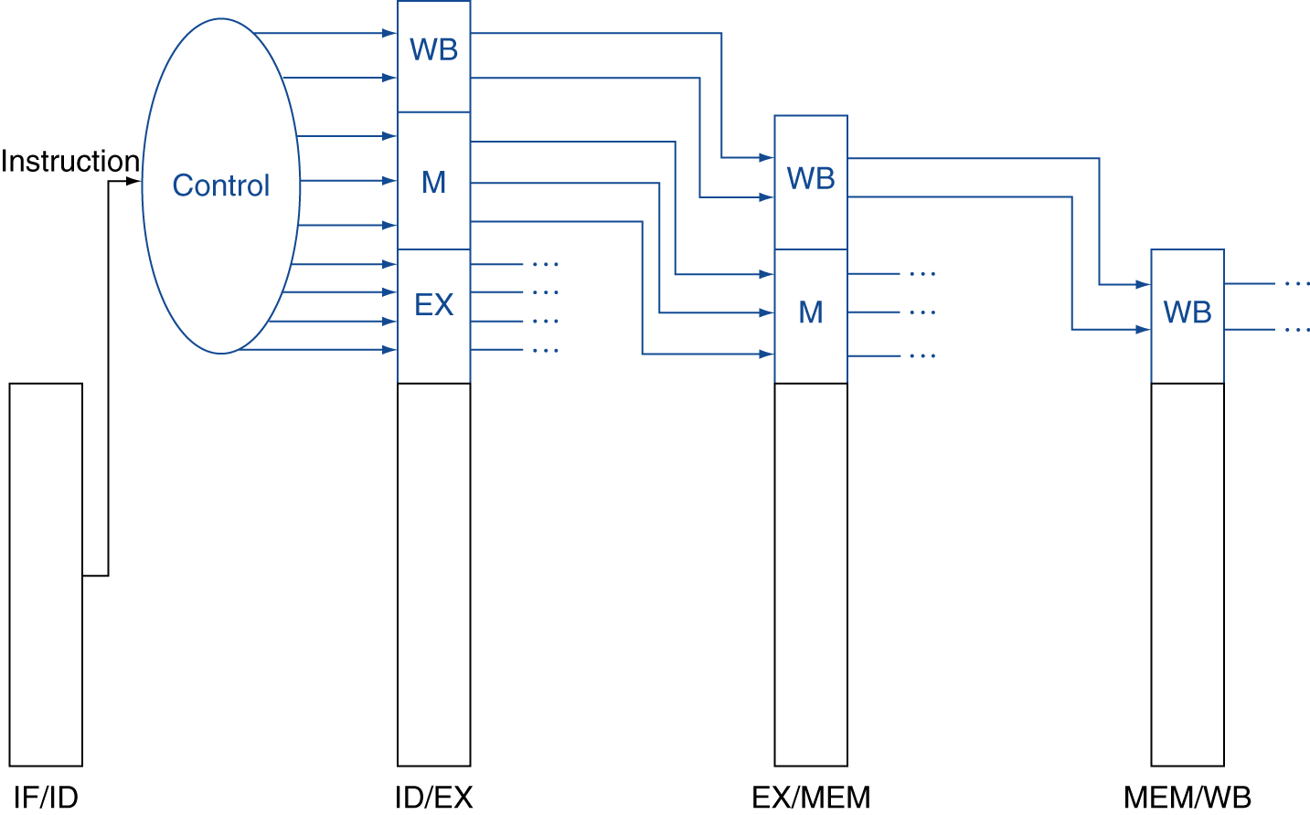
Pipelined Control
Control signals derived from instruction
As in single-cycle implementation

Slide 31
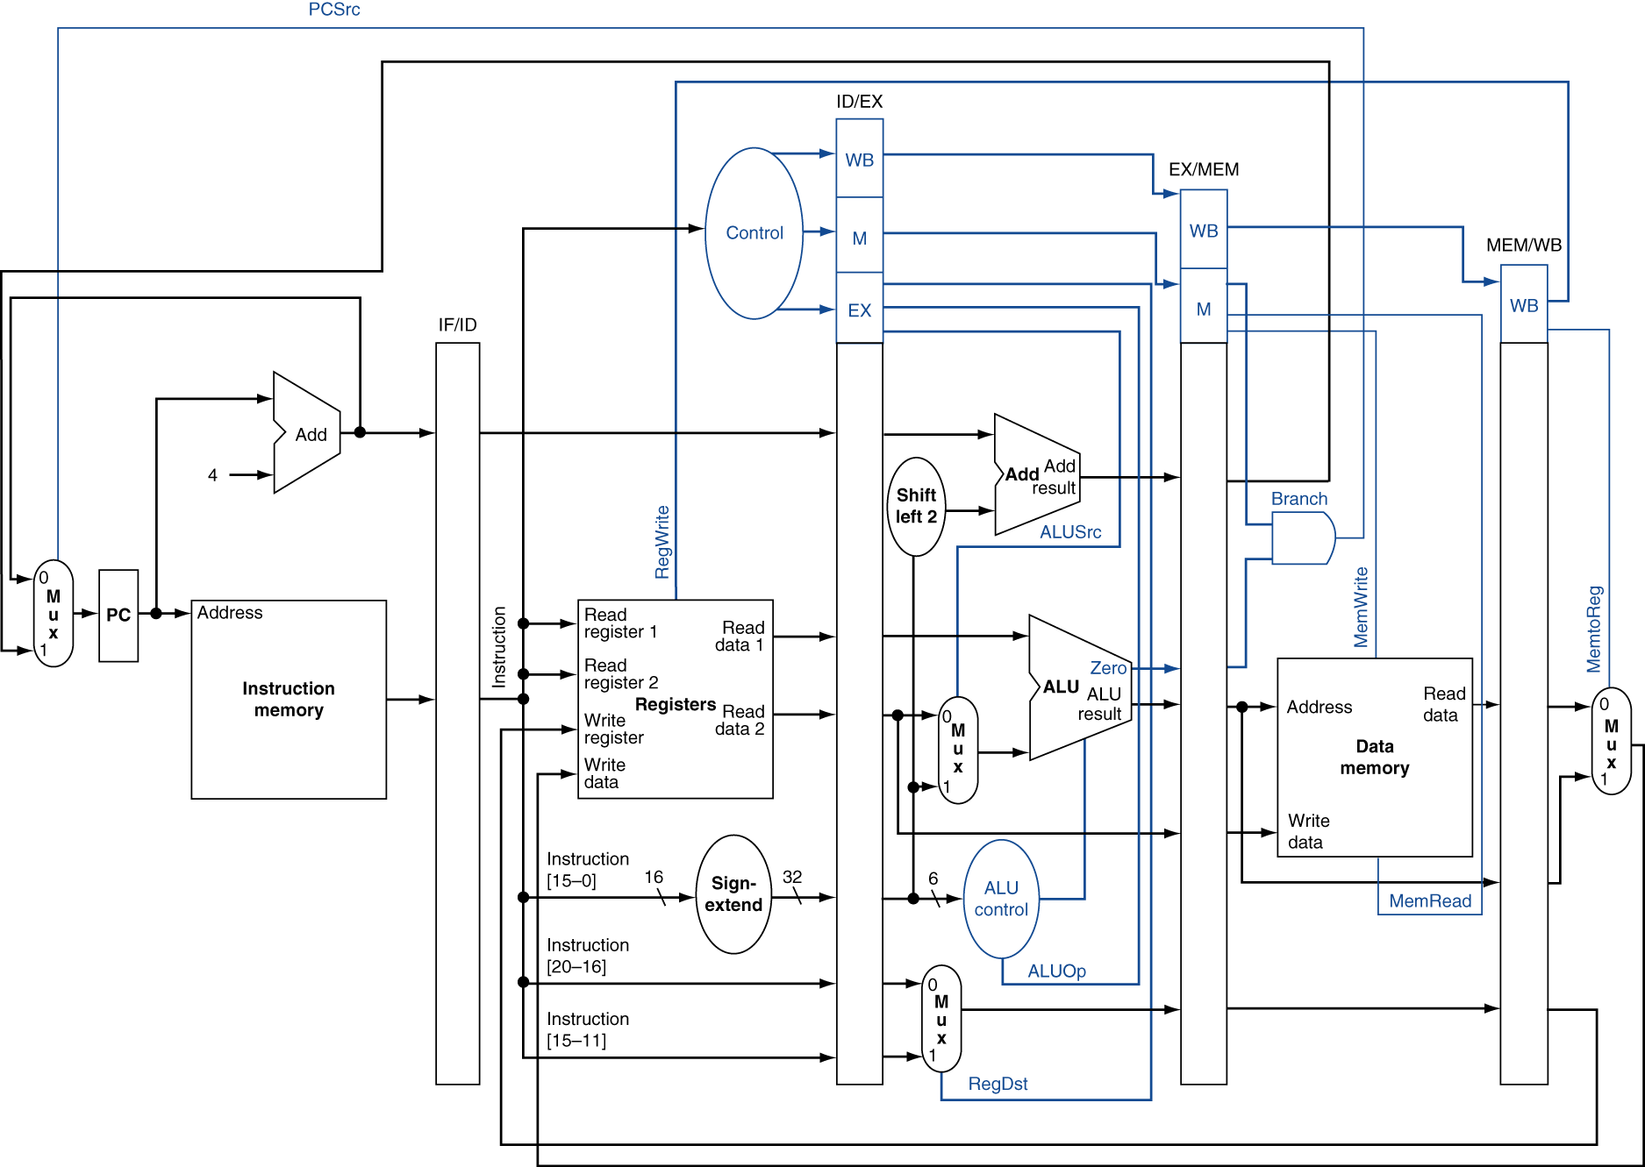
Pipelined Control

